Slide 1
Budgeting Essentials Workshop
Presentation
Notes:
Before the session, you might like to have these weblinks set up, to show the learners during the session:​
​
https://www.moneyhelper.org.uk/en/everyday-money/budgeting/budget-planner ​
https://www.lloydsbank.com/help-guidance/managing-your-money/50-30-20.html
​
Also, look through the scenarios (from Ishan through to Sam). Decide which of these match your audience. Pick at least 1 ‘income’ plus 1 ‘outgoings’ example OR pick 1 ‘full budget’ example – you may decide to include more than 1, depending on your audience needs. Note that Marc and Sam’s budget activities refer to the Workbook. For Jo, Lee and Tony, the activities aren’t in the workbook, but can be worked through together as a group (the ‘answer’ slides follow the ‘question’ slides for each part of these activities).

Slide 2
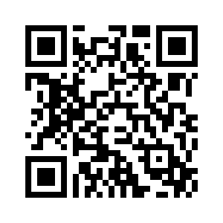
Pre-session survey
Notes:
Encourage learners to scan the QR code here and complete our short pre-session survey around levels of confidence in the session’s topics today, plus what they would like to get out of the session

Slide 3
Welcome

Slide 4

Introductions
Your facilitator today is:
Please introduce yourself to the group
Name something you want to save up for
Notes:
Introduce yourself – state your role today and how you plan to help them​
Let them know this is a safe space to ask questions about money
Encourage them to ask about terms or practices they are unclear on
Learner intros - if it’s a large group, ask them to introduce themselves to the person on their right ​
In their intros, ask them to say what they would save up for, and note their answers to refer to later​
​

Slide 5

Objectives
By the end of this workshop, you should be able to:
Explain what we mean by " budget" and explore the benefits
Create a budget
Explore the types of online budgeting tools available
List the benefits of having an emergency fund
Notes:
This workshop aims to help you create your own budget
Here’s what I’d like you to take away/know by the end of the session
(Read through objectives) ​
​

Slide 6

Today’s Session
Health and safety briefing
Agenda
Welcome
What is a Budget?
Creating a Budget
Online Tools
Emergency Fund
Disclaimer: Everything that is discussed today is for guidance and is not financial advice. Any websites, tools etc. are examples of what's available.
Notes:
Run through basic health and safety (fire exits, trip hazards etc) ​
Run through the agenda ​
Read out the disclaimer: ​
Everything that is discussed today is for guidance and is not financial advice. Any websites, tools etc. are examples of what's available ​
Hand out the workbook and explain they can make notes as we go through the workshop plus there’s some useful links at the back of the books​

Slide 7

What words come to mind when you hear the word "budget"?
Notes:
Ask:​
What words come to mind when you hear the word "budget"? ​
What do you think a budget is?​
Look for: ​
A budget is a plan for how you spend your money. ​
​​
If you have access to a flipchart or whiteboard jot down the answers they give​
(there’s also space for this and the subsequent questions in the workbooks)​

Slide 8
What words come to mind when you hear the word "budget"?
Budgets are a plan for how you spend your money
Notes:
Explain: ​
A budget can help you understand what money is coming in, what's going out, and where you are spending your money ​
​

Slide 9

Budgeting Basics Animation
Notes:
*** NOTE THIS SLIDE IS HIDDEN BY DEFAULT. TO SHOW IT, GO TO ‘SLIDE SHOW’ TAB THEN SELECT ‘UNHIDE SLIDE’ ***
Play the Budgeting Basics animated video embedded on this slide, if appropriate and you have the facilities to do so. ​
To play the video, click anywhere on the slide. ​
The video has sound so make sure you have this turned on. ​
The video can be found here https://youtu.be/IiiqHWWZEXQ ​
​

Slide 10

Why is having a budget important?
Notes:
Ask:​
Why is having a budget important? ​
​
Look for: ​
It’s about giving you control over your money; ​
it can help you see what you might need for unexpected expenses and identify areas where you might want to cut back.​
​
Don't forget to add any points that the learners didn't call out ​

Slide 11
Why is having a budget important?
It can help give you control over your money
Notes:
Ask:​
Why is having a budget important? ​
​
Look for: ​
It’s about giving you control over your money; ​
it can help you see what you might need for unexpected expenses and identify areas where you might want to cut back.​
​
Don't forget to add any points that the learners didn't call out ​

Slide 12
Creating a Budget
Notes:
Let’s look now at how to create a budget.​
​
So by the end of this section, you should be able to: ​
Create a budget ​

Slide 13


Working out your budget
Notes:
Ask: ​
What is the basic formula for creating a budget? ​
​
Look for: ​
Income less expenditure ​
​
ANSWER ON NEXT SLIDE …​

Slide 14
Working out your budget
Budget = Income - outgoings
Notes:
​Check here for understanding of these terms:
Income
Outgoings

Slide 15

Income
Where does this come from?
Wages
Pension
Benefits
Child maintenance
Notes:
***THIS SLIDE IS ANIMATED – CLICK AFTER GROUP HAS OFFERED SUGGESTIONS, TO SHOW THE ANSWERS ***​
Get learners to start thinking about where money might come into them. ​
​
Explain: ​
Your income is anything that is a regular incoming payment, this could be weekly, monthly, quarterly etc. ​
​
Ask: ​
Where could this come from? ​
​
Look for: ​
Wages ​
Pension ​
Benefits ​
Child maintenance ​
Use flipchart / whiteboard to note answers and/or use the space in their workbooks​)
For online sessions, encourage them to use the chat box​ for their suggestions
*** CLICK TO REVEAL THE ANSWERS ***​

Slide 16

Ishan
Ishan is a delivery driver. He gets paid different amounts each month
Ishan wants to make a budget to help him manage the family money but doesn't know where to start
How could Ishan work out his average monthly income?
Notes:
Read out Ishan’s income scenario:​
Ishan is struggling to work out his budget because he has a different amount coming in each month from his job. ​
He’s the only wage earner at home. Some months he struggles to pay his bills. Other times, he has extra money left over. ​
He'd like to start putting away money towards an emergency fund for months when he isn't paid enough to meet all his outgoings. ​
Ask:​
How could Ishan calculate his average monthly income? ​

Slide 17
Ishan's calculations
Date | Income in £
January | 800
February | 1,500
March | 1,000
Total of all 3 months | 3,300
Notes:
Explain: ​
You may have irregular income, just like Ishan ​
To calculate his income, he adds together 3 or 6 months' earnings then divides that number by the number of months used. ​
Let’s work through this example: ​
(at this point, you can mention all these details are in their workbooks, so they can follow from there if they prefer / can’t see the screen)​
He earns £800 in January​
Then he earns £1,500 in February​
And in March, he earns £1000 ​
Added together these come to a total of £3,300. ​

Slide 18
Ishan's calculations
Date | Income in £
January | 800
February | 1,500
March | 1,000
Total of all 3 months | 3,300
Date | Income in £
Total of all 3 months | 3,300
Divide that by the number of months (3) | 3,300 / 3
Average | 1,100
Notes:
Explain: ​
Now, looking on the right of the screen, we start with that total for all 3 months.​
And we divide that by the number of months used to calculate the total) – that’s 3 – to give the average ​

Slide 19
Ishan's calculations
Date | Income in £
January | 800
February | 1,500
March | 1,000
Total of all 3 months | 3,300
Date | Income in £
Total of all 3 months | 3,300
Divide that by the number of months (3) | 3,300 / 3
Average | 1,100
Ishan’s average income per month is £1,100
Notes:
Explain: ​
So Ishan has an average income of £1,100. ​

Slide 20


Beth
Beth lives in a shared flat
She takes the bus to work
She likes nights out with her friends
She has a big credit card bill that she’s paying off slowly
She’s a bit behind on her council tax payments so she's agreed to pay extra each month to help her catch up
Notes:
Explain:​
​Once you’ve worked out your income, it’s time to look at your outgoings.
Ask: ​
What type of outgoings might you have? Take a look at Beth ​
​
Talk through Beth’s outgoings scenario:​
Beth lives in a flat that she shares with two others. She takes the bus to work. In the evenings, she likes to go out with her friends. When she started work, she got a credit card, but she found it all too easy to overspend on it. So she’s trying hard not to use it now, and I
She had also fallen behind in her Council Tax payments so she's called them up and arranged to pay extra each month until the debt is paid off. ​
​

Slide 21
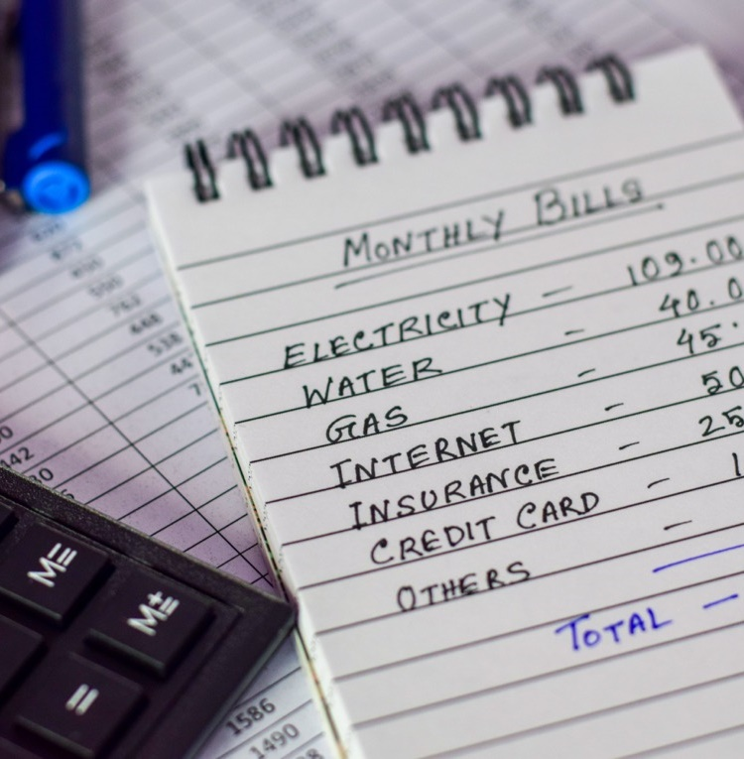
Beth's outgoings
What might Beth's outgoings be?
Utility bills (electric, water, gas)
Food
Rent
Internet / phone
Council Tax
Bus fare
Credit card repayments
Spending money for her nights out
Notes:
***THIS SLIDE IS ANIMATED – CLICK AFTER GROUP HAS OFFERED SUGGESTIONS, TO SHOW THE ANSWERS ***​
Ask: ​
What are her outgoings? ​
​
Look for: ​
Utility bills (electric, water, gas) ​
Food ​
Mortgage ​
Internet/phone ​
Insurance ​
Council tax ​
Bus fare ​
Credit card
Finance repayments (credit card) ​
Debt ​
Use flipchart / whiteboard to note their answers (and / or they can use the space in their workbooks​)
For online sessions, encourage learners to enter suggestions using the chat box​
*** CLICK NOW TO REVEAL THE ANSWERS ***​
Explain:​
Someone else may also have other outgoings such as: ​
Running costs for their car​
TV streaming subscriptions
Irregular payments ​
​

Slide 22
Alek
Alek lives alone in a flat she bought two years ago
She takes the bus to work
She likes to go to the gym in her spare time
She has a small loan which she pays back every month
She’s a bit behind on her council tax payments so she's agreed to pay extra each month to help her catch up
Notes:
Get learners to start thinking about where money might need to be paid to ​
​
Ask: ​
What type of outgoings might you have? Take a look at Alek ​
​
Talk through Alek’s outgoings scenario:​
Alek lives alone in a flat she bought two years ago. She takes the bus to work. In her spare time, she likes to go to the gym. When she needed to buy a new washing machine she took out a small loan to pay for it which she needs to pay back every month. Alek had also fallen behind in her Council Tax payments so she's called them up and arranged to pay extra each month until the debt is paid off. ​
​

Slide 23
Alek's outgoings
What does Alek pay for each month?
Utility bills (electric, water, gas)
Food
Mortgage
Internet / phone
Insurance
Council Tax
Bus fare
Gym subscription
Finance payments
Debt
Notes:
***THIS SLIDE IS ANIMATED – CLICK AFTER GROUP HAS OFFERED SUGGESTIONS, TO SHOW THE ANSWERS ***​
​
Ask: ​
What are her outgoings? ​
​
Look for: ​
Utility bills (electric, water, gas) ​
Food ​
Mortgage ​
Internet/phone ​
Insurance ​
Council tax ​
Bus fare ​
Subscriptions (Gym) ​
Finance payments (loans) ​
Debt ​
Use flipchart / whiteboard to and / or their workbooks​ to note answers
For online sessions, encourage them to reply in the chat box​
*** CLICK TO REVEAL THE ANSWERS ***​
Explain:​
Someone else may also have other outgoings such as: ​
Petrol ​
Credit cards ​
Irregular payments ​
​

Slide 24

Jo
Jo works as a Teaching Assistant
She’s a single parent of two sons
They live in a rented house
She uses her 15-year old car to get to work and take the boys to school
Notes:
​
Introduce Jo’s story – we’re going to look at her details and work out her budget

Slide 25
Activity: Jo’s income
Jo needs to work out her budget
She gets £950 each month from her job, plus £650 in benefits
What is her total income?
Notes:
Activity part 1
Hand out calculators
Individually / in groups – they work out Jo’s income
ANSWER ON NEXT SLIDE
​

Slide 26
Activity: Jo’s income
Jo needs to work out her budget
She gets £950 each month from her job, plus £650 in benefits
What is her total income?
£1,600

Slide 27
Activity: Jo’s outgoings
Jo’s rent is £800 a month
She also spends £200 on utility bills, £110 council tax and £350 on food
Her phone and internet bill is £25. Petrol and car insurance are £50
What is the total of Jo’s outgoings?
Notes:
Activity part 2
Individually / in groups – they work out Jo’s total outgoings
ANSWER ON NEXT SLIDE

Slide 28
Activity: Jo’s outgoings
Jo’s rent is £800 a month
She also spends £200 on utility bills, £110 council tax and £350 on food
Her phone and internet bill is £25. Petrol and car insurance are £50
What is the total of Jo’s outgoings?
£1,535

Slide 29
Activity: Jo’s budget
So, Jo’s total monthly income is £1,600 and her outgoings are £1535
Work out the difference
Notes:
Activity part 3​
Work out the difference between Jo’s income and outgoings
ANSWER ON NEXT SLIDE
​

Slide 30
Activity: Jo’s budget
So, Jo’s total monthly income is £1,600 and her outgoings are £1535
Work out the difference
£65
Notes:
Ask them for ideas or suggestions they would give to Jo to help her reduce her outgoings ​
​
Explain: ​
There are many ways you can reduce your outgoings, start with things like comparison sites ​for broadband, phone packages and car insurance – maybe Jo could call her supplier to see if she could get a better deal
She may be able to save money on her food shopping – what do you think about how much she spends each month on this? (£350)​
​
Discuss: ​
Start a discussion to see if anyone has an example of how they reduced their outgoings that they wouldn't mind sharing ​
​

Slide 31

Lee
Lee gets Universal Credit
He’s just moved into a rented flat
He uses the bus to get around
Notes:
​
Introduce Lee’s story – we’re going to look at his details and work out his budget

Slide 32
Activity: Lee’s income
Lee needs to work out his budget
He gets £285 Universal Credit each month
He also gets £380 PIP
What is his total monthly income?
Notes:
Activity part 1
Hand out calculators
Individually / in groups – they work out Lee’s income
ANSWER ON NEXT SLIDE
​

Slide 33
Activity: Lee’s income
Lee needs to work out his budget
He gets £285 Universal Credit each month
He also gets £380 PIP
What is his total monthly income?
£665
Notes:
​

Slide 34
Activity: Lee’s outgoings
Lee pays £80 each month for gas and electricity
His food bill is £240
He has a bus pass that costs £55 a month
He also pays £160 a month Council Tax
What is the total of Lee’s outgoings?
Notes:
Activity part 2
Individually / in groups – they work out Lee’s total outgoings
ANSWER ON NEXT SLIDE

Slide 35
Activity: Lee’s outgoings
Lee pays £80 each month for gas and electricity
His food bill is £240
He has a bus pass that costs £55 a month
He also pays £160 a month Council Tax
What is the total of Lee’s outgoings?
£535

Slide 36
Activity: Lee’s budget
So, Lee’s total monthly income is £665 and his outgoings are £535
Work out the difference
Notes:
Activity part 3​
Work out the difference between Lee’s income and outgoings
ANSWER ON NEXT SLIDE
​

Slide 37
Activity: Lee’s budget
So, Lee’s total monthly income is £665 and his outgoings are £535
Work out the difference
£130
Notes:
​

Slide 38

Tony
Tony is looking for work
He’s just moved into a shared house
He and his housemates split the bills between them
Notes:
​
Introduce Tony’s story – we’re going to look at his details and work out his budget

Slide 39
Activity: Tony’s income
Tony needs to work out his budget
He gets £285 Universal Credit each month
He also gets £85 Job Seekers Allowance (JSA) every week.
What is his total monthly income?
Multiply his JSA by 4.2
Add this to his Universal Credit
Notes:
Activity part 1
Hand out calculators
Individually / in groups – they work out Tony’s income
Explain why we are multiplying JSA (weekly income) by 4.2 (average number of weeks in a month)
ANSWER ON NEXT SLIDE
​

Slide 40
Activity: Tony’s income
Tony needs to work out his budget
He gets £285 Universal Credit each month
He also gets £85 Job Seekers Allowance (JSA) every week.
What is his total monthly income?
£85 x 4.2 = £357
£357 + £285 = £642
Notes:
​

Slide 41
Activity: Tony’s outgoings
Tony’s rent is £400 a month
His monthly share of bills is £60 for gas and electric, plus £40 council tax
He pays £100 on food and £15 for phone and internet
What is the total of Tony’s outgoings?
Notes:
Activity part 2
Individually / in groups – they work out Tony’s total outgoings
ANSWER ON NEXT SLIDE

Slide 42
Activity: Tony’s outgoings
Tony’s rent is £400 a month
His monthly share of bills is £60 for gas and electric, plus £40 council tax
He pays £100 on food and £15 for phone and internet
What is the total of Tony’s outgoings?
£615

Slide 43
Activity: Tony’s budget
So, Tony’s total monthly income is £642 and his outgoings are £615
Work out the difference
Notes:
Activity part 3​
Work out the difference between Tony’s income and outgoings
ANSWER ON NEXT SLIDE
​

Slide 44
Activity: Tony’s budget
So, Tony’s total monthly income is £642 and his outgoings are £615
Work out the difference
£27
Notes:
Activity part 3​
Ask them for ideas or suggestions they would give to Tony to help reduce his outgoings ​
​
Explain: ​
There are many ways you can reduce your outgoings, start with things like comparison sites ​for broadband and phone packages– maybe Tony could call his supplier to see if he could get a better deal
​
Discuss: ​
Start a discussion to see if anyone has an example of how they reduced their outgoings that they wouldn't mind sharing ​
​

Slide 45

Activity: Marc’s budget
Look at Marc’s story in your workbook. Using the budget sheet jot down the following:
Marc's income
Marc's outgoings
Calculate the difference
How could Marc save money each month?
Notes:
Workbook activity – Create a budget for Marc ​
​
Hand out the calculators ​
Split the class into smaller groups or pairs ​
Point the learners to Marc's story in their workbooks ​
•Ask them to write Marc's incoming money into the budget form in the workbook (950 + 500 + 87.20 = £1,537.20)
•Next, ask them to write down Marc's outgoings into the budget (167 + 40 + 350 + 800 + 17 + 10 + 110 + 10 = £1,504)
•Finally, ask them to calculate the difference (1537.20 – 1504 = £33.20) ​
Ask each team to read out the resulting difference ​
​
Activity – Improve Marc's budget ​
Keep the learners in their groups ​
Ask them to jot down a list of suggestions they would give to Marc to help him reduce his outgoings ​
Ask each group for feedback on their ideas ​
​
Explain: ​
There are many ways you can reduce your outgoings, start with things like comparison sites ​
Call your supplier and see if you can get a better deal ​
Consider changing where you shop ​
​
Discuss: ​
Start a discussion to see if anyone has an example of how they reduced their outgoings that they wouldn't mind sharing ​
​

Slide 46
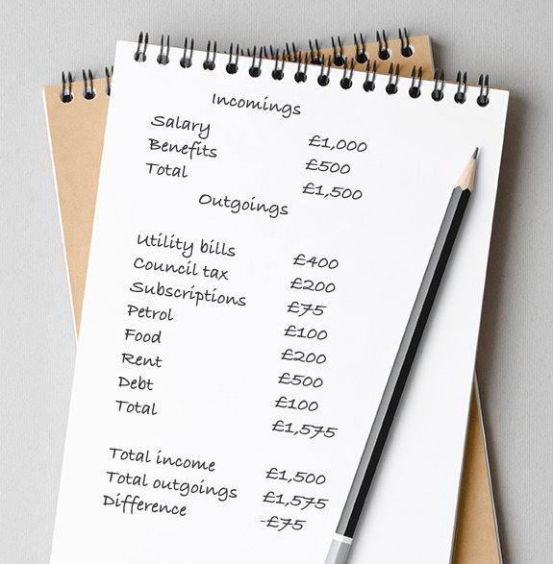
Activity: Sam's budget
Take a look at Sam's budget in your workbooks
Sam has more outgoings than income
What actions could Sam take to
reduce her outgoings?
Notes:
Workbook activity – Sam’s budget
Explain: ​
Take a look at Sam's budget in your workbooks ​
Sam has more outgoings than incoming ​
In a bid to correct this, she managed to reduce her outgoings by undertaking the following actions: ​
First, she used a comparison site to help her switch her energy supplier ​
Looking through her budget she spotted a magazine subscription she no longer used so she cancelled that ​
She then reduced her food spending by switching supermarkets and signed up for their loyalty programme to give her discounts ​
She asked to reduce the payment plan for her debts ​
Finally, she looked to see if she was eligible for further government support through charities such as Turn2Us ​
Point learners to the section at the back of the workbook with a list of charities and what support they provide ​
PAUSE HERE AND CHECK HOW THE LEARNERS ARE FEELING – SO YOU CAN ADJUST THE TRAINING AS NEEDED​​

Slide 47
Online Tools
Notes:
Now let’s look at online tools that can help you budget.​
And by the end of this section, you should be able to: ​
Explore the types of online budgeting tools available. ​

Slide 48
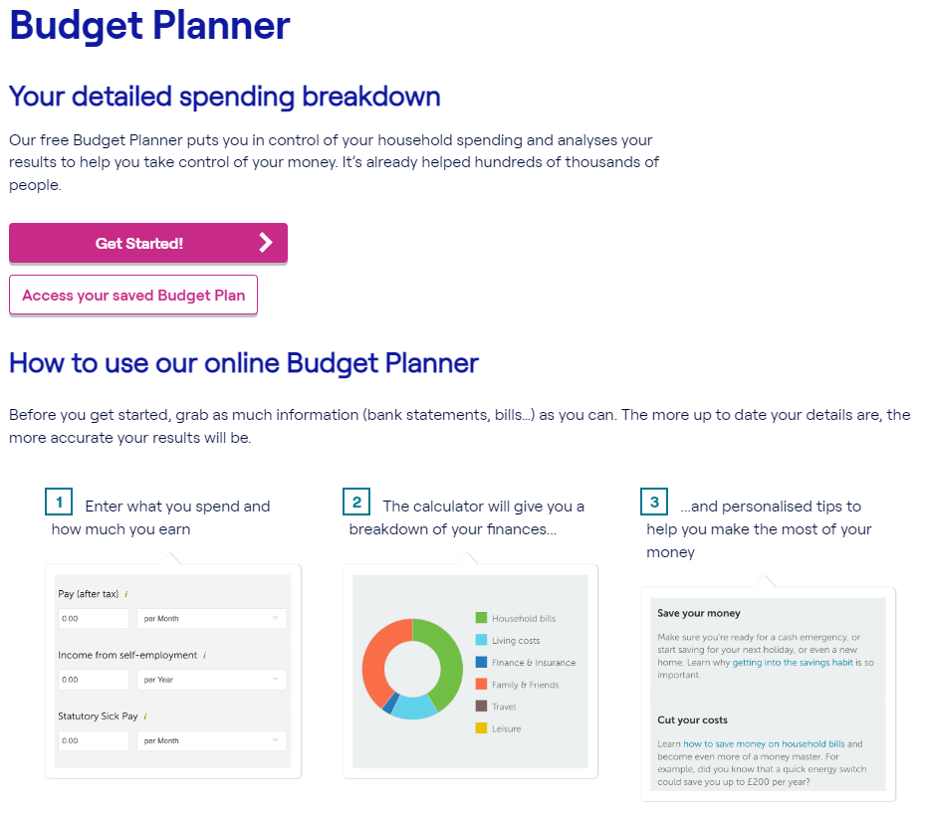

Did you know …
there are online tools that can help you calculate your budget?
Notes:
Explain: ​
There are online budgeting tools which can help you. These do the calculations and can make suggestions to help you save money. You will have to learn how to use them, but in the long term, they may help you save money and time in a way that pen and paper can’t ​
Most bank websites have these kind of tools
There are also other sites like Money Helper. These organisations are government-approved and trusted to give advice and guidance on a wide range of issues ​
​
If you have access to the internet show Money Helper website ​
https://www.moneyhelper.org.uk/en/everyday-money/budgeting/budget-planner ​
If you have time you could start to walk the learners through the money helper budget tool ​

Slide 49
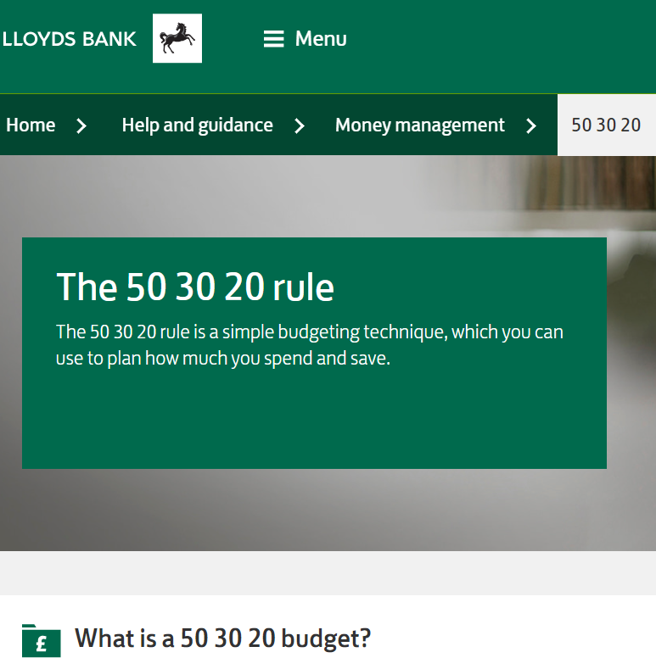

Where else can you find tools to help you budget?
Spreadsheet tools
Websites
Mobile apps
Benefit claim checkers
Comparison tools
Notes:
***THIS SLIDE IS ANIMATED – CLICK AFTER GROUP HAS OFFERED SUGGESTIONS, TO SHOW THE ANSWERS ***​
Ask: ​
Where else can you find tools to help you budget? ​
​
Look for: ​
Spreadsheet tools (which have budgeting templates available) ​
Websites e.g. Money Saving Expert ​
App store on your device (mobile or tablet) ​
Benefit claim checkers ​
Comparison tools ​
Explain: ​
Spreadsheet tools can help speed up budgeting and make it easier. You will need to learn how to use them, although they usually offer readymade budgeting templates. Once you do, you can use them to create sheets that will automatically calculate your budget for you. So, you can easily change the amounts in your income or outgoings as they change each month. The spreadsheet will then automatically calculate your budget and tell you the new balance ​
Banking websites often have useful tips and tools on helping with budgeting and money management – like this article which talks about a specific budgeting technique called the 50-30-20 rule, where you spend 50% of your income on ‘needs’, 30% on ‘wants’ and 20% on savings (TRAINER NOTE: The screenshot here is a clickable link, to use / show if required)
Why not take a look at your device's app store. Check out their money category. Here, you’ll find some recommended and commonly used apps which may be able to help you to budget ​
Always check the apps, websites and tools are well-reviewed, safe and trusted. For instance, look at reviews on your device's app store. Sometimes, the best way to find out what tools are good is to ask the people you trust for recommendations based on which tools they use too ​

Slide 50

Online tools – questions to ask
How much do I want to spend?
Is the tool safe?
What do I want it to do?
How do I want to access them?
Notes:
Explain: ​
Other things to consider when choosing a tool are: ​
How much do you want to spend? Some apps are free, and some will cost. Ask yourself if they’re worth the added cost ​
Are they safe? Do you want to share your financial information with them or connect them to your bank account? If you do, are they well-reviewed and trusted by others? ​
What do you want to do? What features are you looking for? Do you want to make the calculations easier, get suggestions on how to cut down or is there another goal in mind? ​
How do you want to access them? Some tools work better on some devices than others. Others will only work on a particular type of device. So, you should keep in mind what kind of device you would like to use them on. ​
​
​

Slide 51
Emergency Fund
Notes:
Now, let’s think about putting money aside for emergencies. ​
And by the end of this section, you should be able to: ​
List the benefits of having emergency money ​

Slide 52

Data
Over 40% of people in the UK don't have enough money saved to cover them for a month if they lose their income
Source: https://blog.moneyfarm.com/
Notes:
Explain: ​
Recent data suggests that over 40% of people in the UK don't have enough money saved to cover them for a month if they lose their income ​
It can be useful to have savings to fall back on when money is tight. Savings don't have to involve large amounts, just putting away a few pounds (or even £1) can soon start to build up ​
​

Slide 53
Which of the following amounts should you try to save for your emergency fund?
Three months outgoings
Three months income
£1,000
A
B
C
Notes:
Ask: ​
Which of the following amounts should you try to save for your emergency fund? ​
Three months expenses ​
Three months income ​
£1,000 ​
Exercise: ​
If you think the answer is a, stand on the left side of the room ​
If you think the answer is b, stand on the right side of the room ​
If you think the answer is c, stand at the back of the room ​
If you have a small group, or learners with accessibility issues, you could ask them to hold their hands up instead ​
For online sessions, ask learners to type their answer (A, B or C) into the chat box​
Comment on how many people thought of each answer as the correct one ​
Explain: ​
There’s no right or wrong answer! It very much depends on your personal circumstances ​
Explain: ​
Ideally, you should have three months of expenses saved up as an emergency fund, however, start yourself with a lower aim, and you can build up from there ​
Once you have done your budget, you should be able to see how much spare income you have left after your expenses. Set aside a regular amount of this to add to your savings account each month ​
​

Slide 54

Discussion
Discuss the different ways you could start to save small amounts of money
Notes:
Ask: ​
What are different ways you could start to save small amounts of money? ​
Discuss the different methods you could try ​
​
Explain ​
The more you can save the quicker it will add up, but the amount you can save will be guided by your budget ​
Make sure your budget is up to date so that you can see clearly how much you can afford to save ​
However long it takes you to save the money, you'll be glad you did – if an emergency comes along, it will be there for you to use – and it will be a lot cheaper than having to take out a loan or credit card, both of which are expensive ways to borrow money ​
Once you reach your target, set yourself a new one but make sure you congratulate yourself for getting there, remember you started with nothing! ​

Slide 55

Activity:
Starting an Emergency Fund
Look at the two budgets shown on the Activity – Starting an Emergency Fund page of the workbook
Work out how much each person could put away into their emergency fund each month
Notes:
Exercise: ​
Look at the two budgets in your workbook and work out how much each person could put away into their emergency fund each month ​
Share and compare results ​
​
Allow the learners to do this in pairs if they prefer ​
There's no exact right answer, as long as the amount is less than the difference between incomings and outgoings​
​

Slide 56
Budgeting Essentials Recap
You should now be able to:
Explain what we mean by " budget" and explore the benefits
Create a budget
Explore the types of online budgeting tools available
List the benefits of having an emergency fund
Notes:
Review the workshop with the delegates by running back through the objectives and reminding them about their goal they would put money towards at the end of the month ​
You should now be able to: ​
Explain what we mean by the term "Budget" and explore the benefits ​
Create a budget ​
Explore the types of online budgeting tools available ​
List the benefits of having emergency money ​
Explain: ​
We've discovered that a budget is a great way to take control of your money. ​
We've looked at lots of tools you can use to help you to create your budget ​
We've also looked at ways to reduce your outgoings ​
Finally, we've discovered that you don't have to have lots of money to start an emergency fund, you can start small​
​
​

Slide 57
Any questions?
Notes:
Ask the learners if they have any questions about what's been covered.
Encourage learners to help and support each other.

Slide 58
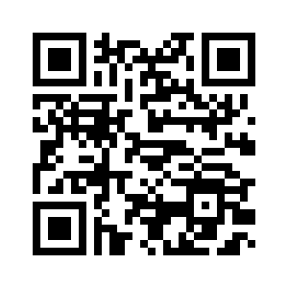
Post-session survey
Notes:
Encourage learners to scan the QR code here and complete our short post-session survey around levels of confidence now they have completed the training, plus any other comments or feedback about the session

Slide 59
Lloyds Bank Academy *Ends*
Notes:
Explain: ​
This is the end of this workshop. Thank you for attending we hope it's been useful ​
Please keep your workbooks so that you can refer back to your notes ​
The workbook also contains helpful links to information on the internet as well as an explanation to financial terms to help you understand the terminology of budgeting ​
​

