Slide 1


Independent living
Managing living expenses
Let’s talk about money
This material is intended for information purposes only and does not constitute advice or a recommendation.

Slide 2

Introduction
Today you will be learning about:
Moving out – what will it cost?
Balancing the budget.
The next move – owning or renting?

Slide 3


Activity A
Moving out – what will it cost?
What are the pros and cons of living independently?
What do you use your money for now if you live with family, carers or friends?
When you live independently, there are lots of things that cost money. In your groups, discuss and write down all of the things that you can think of that you will need to pay for.

Slide 4

Activity A – round up
Moving out – what will it cost?
Key learning:
It is important to be clear about why you want to live independently.
You need to know what you will have to pay for if you start to live independently.
You may have to register for or set up utility bills and Council Tax when you live independently.
Explore the different payment options for bill payments, as some may work out more cost-effective than others.
Consider separating bills and income.

Slide 5
In your groups, did you answer these questions?
How much will it cost Jed each month to live independently?
How much more is it than living at home?
Can he afford to live independently?
Is Jed managing his money well?
Is there anything he hasn’t thought of?
Activity B
The balancing act
Jed’s income | What comes in | Jed’s expenditure per month | What goes out
Trainee online game developer Monthly income (net pay) | £1100.00 | Rent
 |  | Council Tax
 |  | Water
 |  | Gas/Electric (dual fuel)
 |  | TV package / broadband / mobile phone
 |  | TV licence
 |  | Contents insurance
 |  | Food/shared consumables
 |  | Socialising
 |  | Travel
 |  | Clothes
 |  | Savings
Total | £1100.00 | Total

Slide 6
How did you get on with calculating Jed’s new lifestyle?
Activity B
The balancing act
Jed’s income | What comes in | Jed’s expenditure per month | What goes out
Trainee online game developer Monthly income (net pay) | £1100.00 | Rent | £300.00
 |  | Council Tax | £75
 |  | Water | £10
 |  | Gas/Electric (dual fuel) | £30
 |  | TV package / broadband / mobile phone | £45
 |  | TV licence | £7.50
 |  | Contents insurance | £30
 |  | Food/shared consumables | £130
 |  | Socialising | £200
 |  | Travel | £100
 |  | Clothes | £120
 |  | Savings
Total | £1100.00 | Total | £1047.50

Slide 7

Activity B – round up
The balancing act
Key learning:
You will have a lot to think about when you move into independent living. If you are unsure, talk to others – friends, family and supportive adults.
It is important to fully understand all of the things that you will need to take responsibility for once you live independently.
Your spending habits may need to change to be able to afford to live independently or to achieve a goal.

Slide 8
Activity C – The next move? My first home?
Do you know the difference?
For Sale
For Rent
Room to Rent
Buying
This is when you buy a property.
This usually involves taking out a mortgage.
A mortgage is a loan of money from a bank or other mortgage providers.
To get a mortgage on a property, you usually need a deposit
(a percentage of the |purchase price).
Renting your own place
This is when you pay a set amount of money for the use
of a house or a flat.
The owner of the property is known as the landlord.
If you rent, you are called
the tenant.
Renting in a shared property
Similar to renting your own place.
If you are in shared property, some bills may be split between the tenants or included in the monthly rent.

Slide 9
Activity C – The next move? My first home?
Do you know the difference?
For Sale
Shared Ownership
Shared Ownership
Shared Ownership
This is a way of owning part of a property. You might be able buy 25%, 50% or 75% of it.
Whatever portion you own, you will pay rent on the remainder.
Many housing associations offer shared ownership options.
It is a way of making affordable homes available to people with lower income or particular needs.
Joint Tenants
This is another way of owning part of a property.
This usually involves taking out a joint mortgage held by two people.
Joint tenants have equal rights to the property.
Tenants in common
This is another way of owning part of a property.
This usually involves taking out a joint mortgage held by two people.
Tenants in common each own a separate share of the property.
These shares don’t have to be equal size
This can help people to buy property who otherwise could not afford it.
If you want to sell the property, you must still all agree.

Slide 10
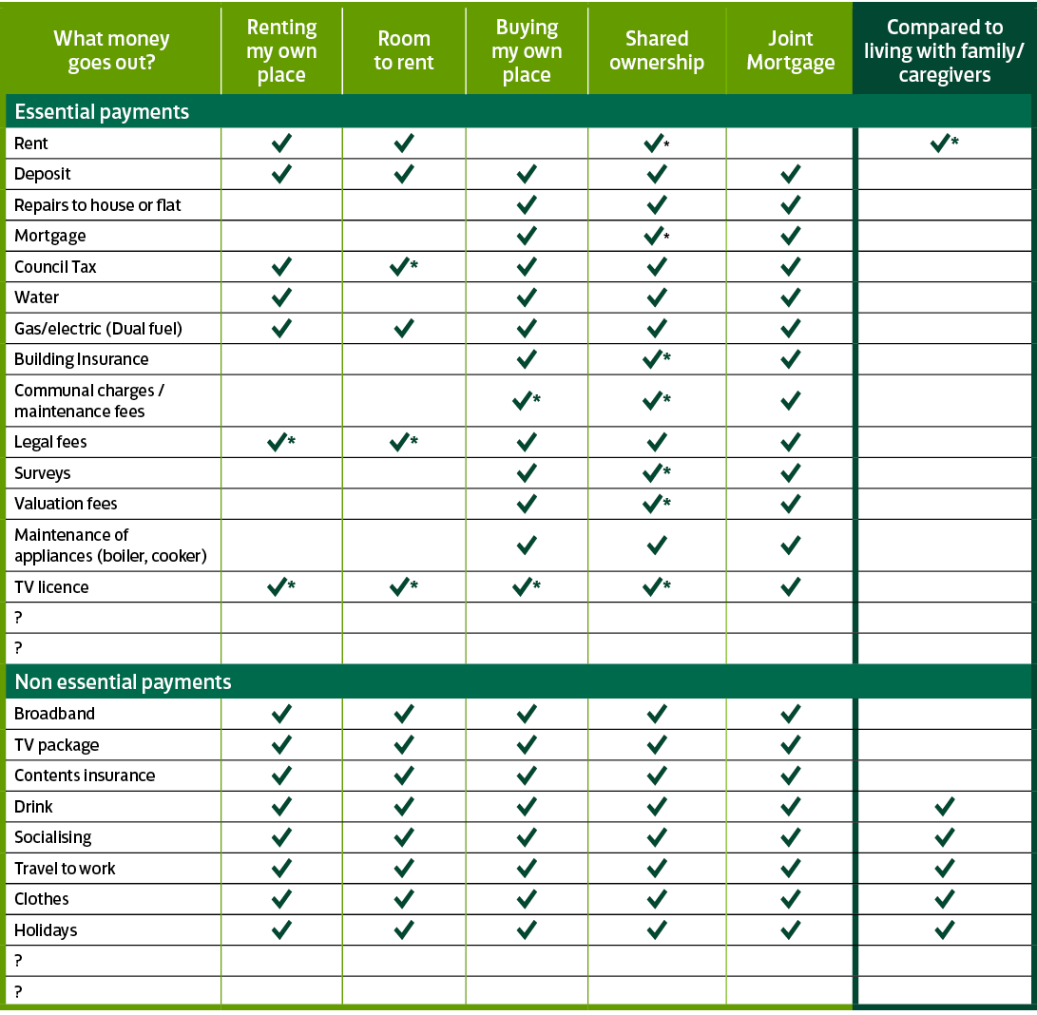
Activity C
The next move? My first home
Let’s compare our answers.
Do you know which of these are ‘no choice’ expenses and which are ‘your choice’?

Slide 11

Activity C – Round up
The next move? My first home
Key learning:
To help you manage your money, it is important to understand the costs associated with living independently, and be able to differentiate between essential and non essential.
Your spending habits may need to change to achieve a goal. This may include saving for a house deposit.
You may want to consider putting money aside regularly for any unexpected events.
There are lots of tools and organisations that can help you to make informed choices about managing your money.

Slide 12

Thank you!

