Slide 1
What do I want and need?
Let’s Talk About Money
This material is intended for information purposes only and does not constitute advice or a recommendation.

Slide 2
Let’s get started
Today you will be learning about the things that people want and need. You will learn about how people make choices about spending their money.

Slide 3
I’ll tell you what I want…
OR

Slide 4
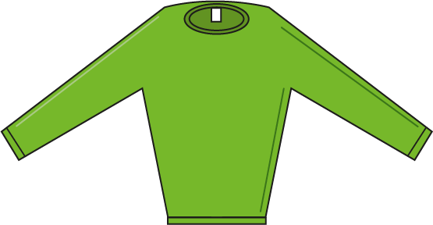
My needs and my wants

Slide 5
My needs and my wants
Needs (Essentials)
Wants (Not Essential)

Slide 6
Our classroom
What do we need and want in our classroom?

Slide 7
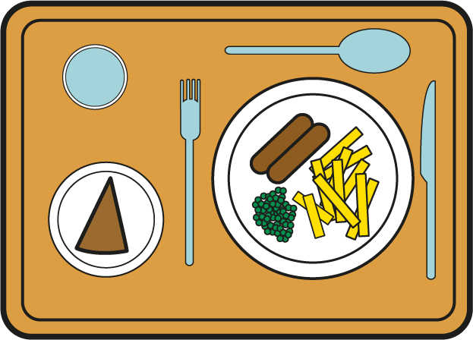
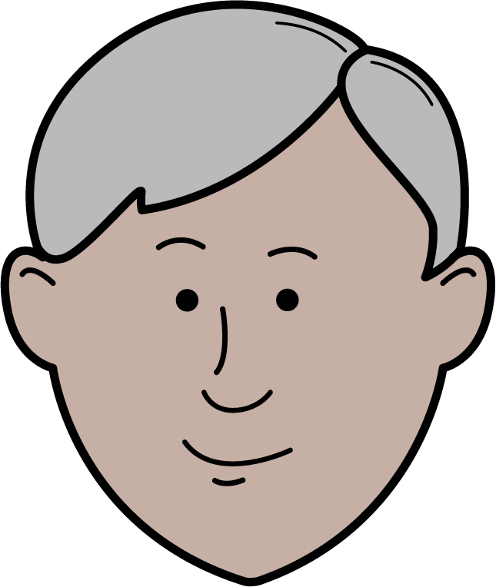
Our school
What do we need and want in our school?
Food and drink
Playground
Activities
Teachers
PE Equipment
A big screen TV for our school hall

Slide 8
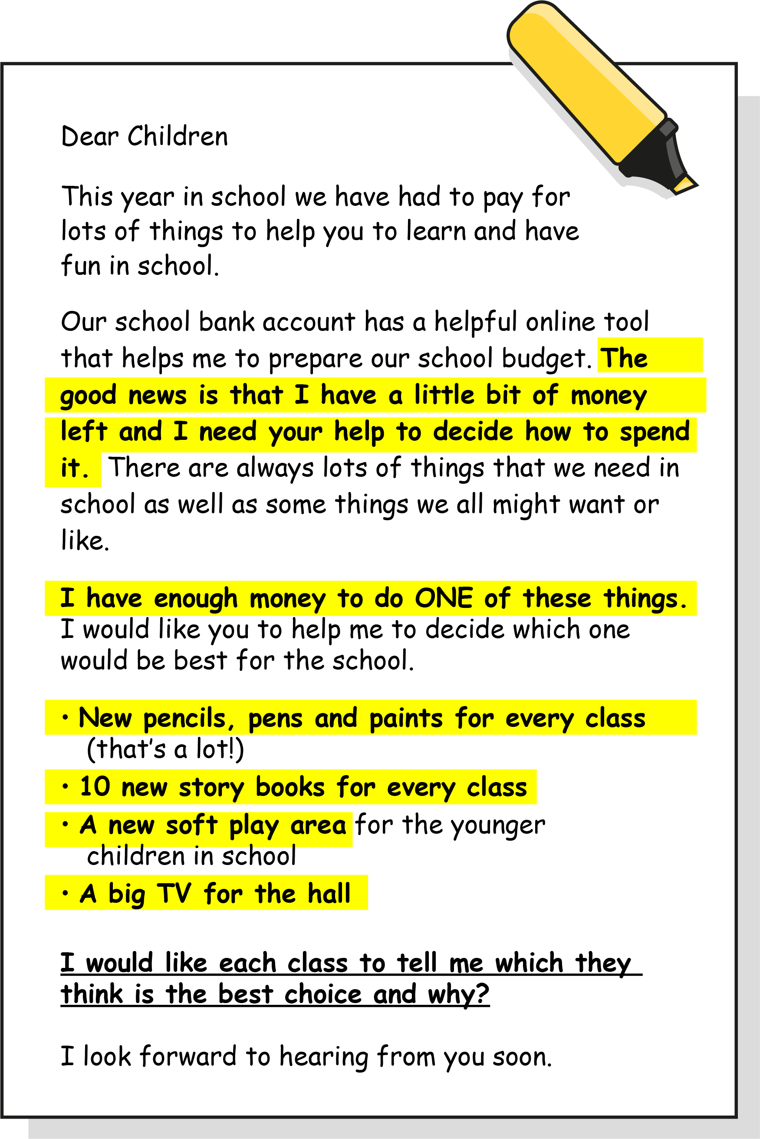
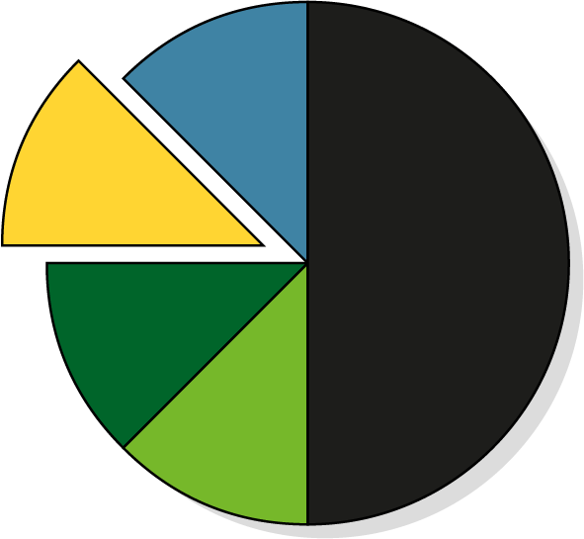
Making choices – Let’s imagine!
Keeping our school clean and safe
Still to spend
Teachers and other helpers
Tables and chairs for the classrooms
Pens/pencils/ paper/books

Slide 9
Making choices
Which is the best choice for our school?
x10
New pens, pencils and paints for every class
10 new story books for each class
A new play area
A big screen TV for our school hall

Slide 10
What have we learnt today?
Can somebody tell me one thing they want but they don’t really need?
Can somebody tell me one thing that they really need?
How can we get the things we need and want?

Slide 11
My needs and my wants

Slide 12
My needs and my wants
Needs (Essentials)
Wants (Not Essential)

Slide 13
A big thank you!

